Slide 1

FILE Management
Er. Deeyoranjan Dongol

Slide 2
FILE SYSTEM
How to store large amount of data?
What happens to the data if the process gets terminated?
How to assign same data to multiple processes?
The solution to these problems is to store information on disks or on external media called files

Slide 3
FILE SYSTEM
A File is named collection of related information normally resides on a secondary storage device such as disk or tape
Files represents program and data
Information stored in files must be persistent
The part of OS that is responsible to manage files is known as file system

Slide 4
FILE SYSTEM
File Naming
When a process creates a file, it gives the file a name, while process terminates, the file continue to exist and can be accessed by other processes
A name is string of characters and may be digits or special characters
Can have maximum of
8 characters [MSDOS]
255 characters[Windows 2000]
Many OS support two-part file names- filename and file extension are separated by a period (.)
File Extension indicates something about the file

Slide 5
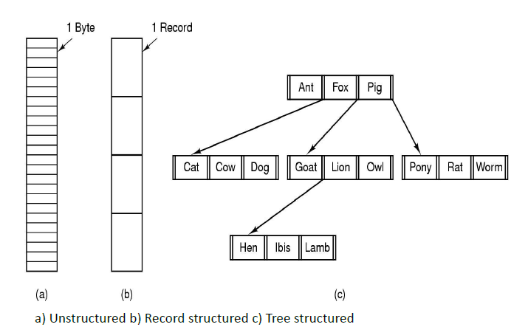
FILE STRUCTURE

Slide 6
FILE STRUCTURE
Most common structures
Unstructured
Consists of unstructured sequence of bytes
OS does not know or care what is in file
Record Structured
Sequence of fixed length records, each with some internal structure
Each read/write operation performed on one record
Tree Structure
Consists of tree of records, may differ in length
Each contains a key field in fixed position in the record, sorted via key to allow rapid searching
Notes:
.

Slide 7
FILE TYPES
Several types of files
Regular files
Contains user information and generally ASCII or binary
Directories
System files for maintaining the structure of file system
Character Special files
Related to I/O and used to model serial I/O devices such as terminals, printers
Block Special files
Used to model disks
Notes:
.

Slide 8
FILE TYPES
ASCII Files
Consists of line of text
Each line is terminated either by carriage return character or line feed character or both
Can be displayed and printed as is and can be edited with ordinary text editor
Binary files
Consists of sequence of byte only
Have some internal structure known to programs that use them(executable or archive files)
Notes:
.

Slide 9
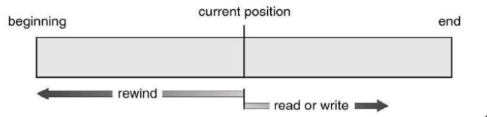
FILE ACCESS
Sequential Access
Information in file is processed in order
One record after other
Convenient when storage medium is magnetic tape
Direct Access
Based on disk model of file
Numbered sequence of bytes or records
Bytes/records can be read in any order
Database Management System
Notes:
.

Slide 10
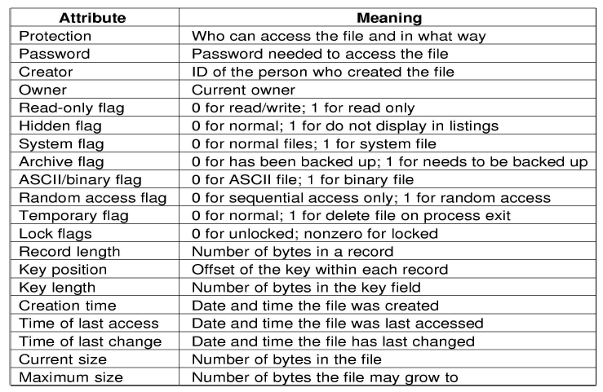
FILE ATTRIBUTES
Notes:
.

Slide 11
FILE OPERATIONS
OS provides some system calls to perform operations on files
Create
Delete
Open
Close
Read
Write
Append
Seek
Get Attributes
Set Attributes
Rename
Notes:
.

Slide 12
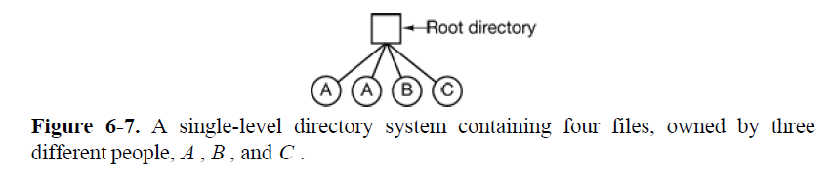
DIRECTORY STRUCTURE
Single-Level Directory
All files are contained in one directory i.e. root directory
Easy to understand but difficult to manage large amount of files and to manage different users
Notes:
.

Slide 13
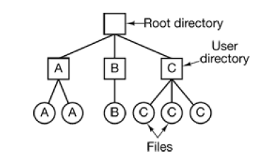
DIRECTORY STRUCTURE
Two-Level Directory
Separate directory for each user
Causes problem when users want to access one another’s files and when single user has large number of files
Notes:
.

Slide 14
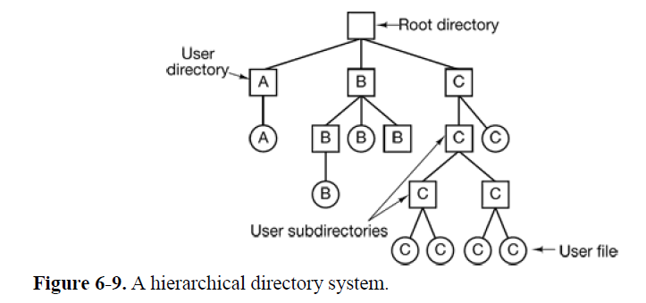
DIRECTORY STRUCTURE
Hierarchical Directory
Generalization of two level structure to a tree of arbitrary height
Allow user to create their own subdirectories and organize them accordingly
Notes:
.

Slide 15
PATH NAMES
Two different methods are used
Absolute Path Name
Path name starts from root directory to a file
e.g. In Unix: /usr/user1/bin/lab2
Relative Path Name
Concept of working directory
A user can designate one directory as the current working directory, in which case all path names not beginning at the root directory are taken relative to the working directory
e.g. bin/lab2 is enough to locate same file if current working directory is /usr/user1
Notes:
.

Slide 16
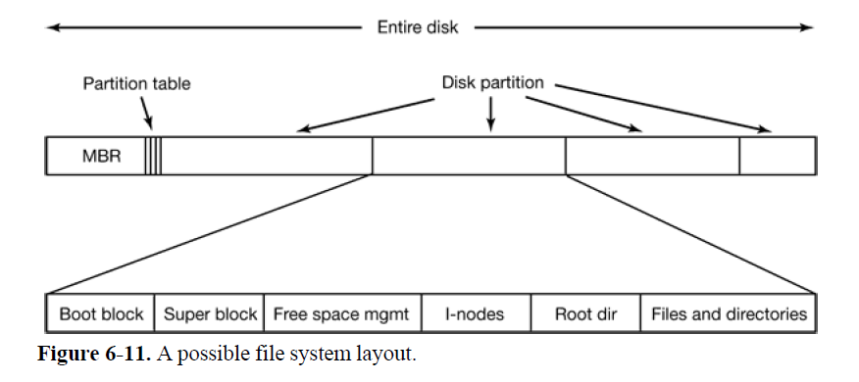
FILE SYSTEM IMPLEMENTATION
File System Layout
Disks are divided up into one or more partitions, with independent file system on each partition
Notes:
Sector 0 of the disk is called the MBR (Master Boot Record ) and is used to boot the computer. The end of the MBR
contains the partition table. This table gives the starting and ending addresses of each partition. One of the partitions in the table is marked as active. When the computer is booted, the BIOS reads in and executes the MBR. The first thing the MBR program does is locate the active partition, read in its first block, called the boot block , and execute it. The program in the boot block loads the operating system contained in that partition.
superblock -> It contains all the key parameters about the file system and is read into memory when the computer is booted or the file system is
first touched. Typical information in the superblock includes a magic number to identify the file system type, the number of blocks in the file system, and other key administrative information

Slide 17
FILE SYSTEM IMPLEMENTATION
Allocation Methods
Contiguous Allocation
Each file occupy a set of contiguous block on the disk
With 2-KB blocks, 50-KB file would be allocated 25 consecutive blocks
Advantages
Simple to implement; accessing a file that has been allocated contiguously is easy
High performance; entire file can be read in a single read operation
Problems
Fragmentation
Pre- information of file size is needed

Slide 18
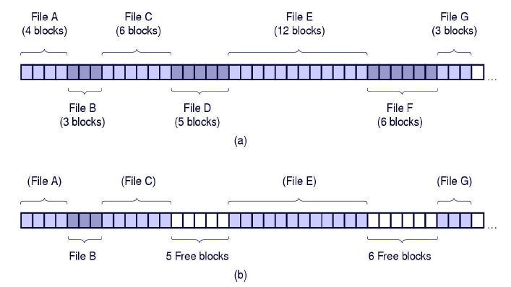
FILE SYSTEM IMPLEMENTATION

Slide 19
FILE ALLOCATION METHODS
Linked List Allocation
Each file is a linked list of disk blocks
Each block contains pointer to the next block of same file
Problem
Sequential access. Random access is slow
Requires space for pointer
Solution
Using File Allocation Table(FAT)
One entry for each disk block containing next block number for the file

Slide 20
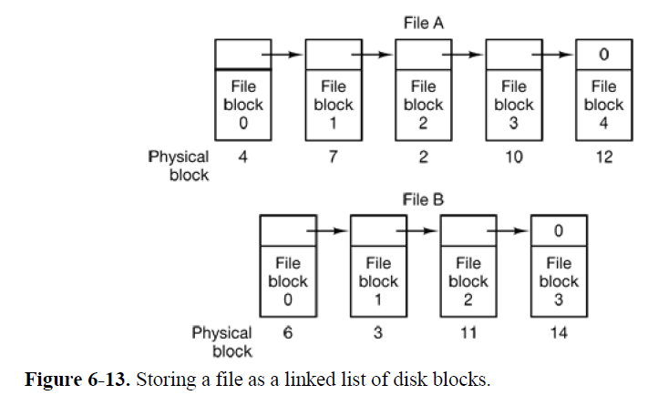
FILE SYSTEM IMPLEMENTATION

Slide 21
FILE ALLOCATION METHODS
Linked List Using FAT
FAT is used as linked list
Directory entry contains block number of first block of the file
FAT is looked to find next block until special end-of-file value is reached
Advantages
Entire block is available for data
Improved random access
Problem
The entire table must be in memory all the time to make it work

Slide 22
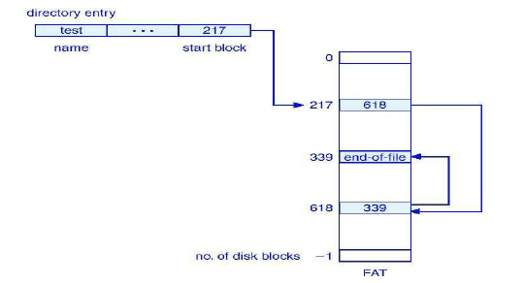
FILE SYSTEM IMPLEMENTATION

Slide 23
FILE ALLOCATION METHODS
I-node
Each file has a data structure(i-node) that list the attributes and disk addresses of the disk block associated with the file
If i-node occupies n bytes for each file and k files are opened, the total memory by i-nodes is kn bytes
Advantages
Far smaller space occupied by FAT
Problems
Suffer from performance

Slide 24
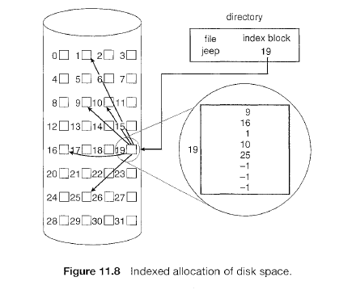
FILE SYSTEM IMPLEMENTATION

Slide 25
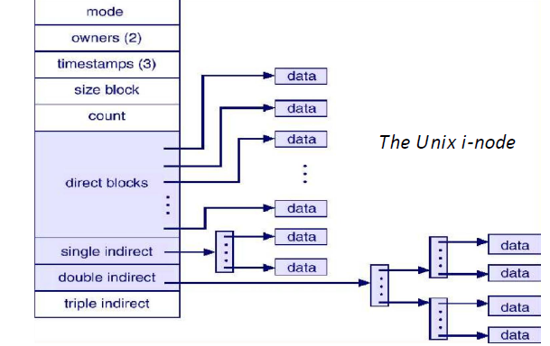
FILE SYSTEM IMPLEMENTATION

Slide 26
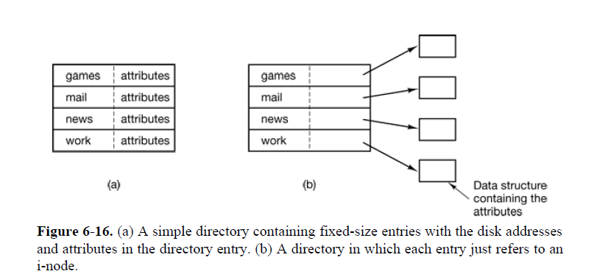
DIRECTORY IMPLEMENTATION

Slide 27
DISK SPACE MANAGEMENT
Block Size
Nearly all file systems chop files up into fixed size block
Using large size result the wastage of disk space
Using small size increase the seek and rotational delay - low data access rate

Slide 28
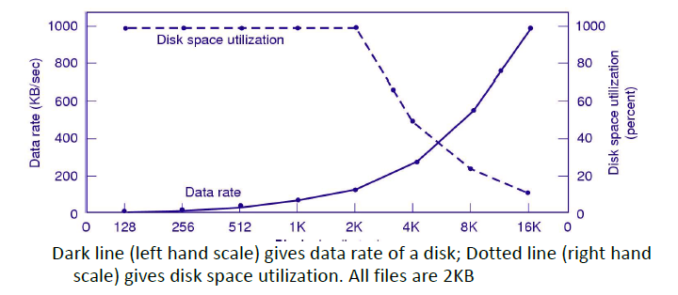
DISK SPACE MANAGEMENT

Slide 29
DISK SPACE MANAGEMENT
Keeping Track of Free Blocks
To keep track of free blocks, system maintains the free-space-list
Free-space-list records all free blocks that are not allocated to some file or directory
To create a file, system search the free-space-list for required amount of space, and allocate space to new file and remove it from list
When a file is deleted, its disk space is added to free-space-list

Slide 30

DISK SPACE MANAGEMENT
Free-space-list implementation approach
Consider a disk where blocks 2, 3, 4, 5, 8, 9, 10, 11, 12, 13, 17, 18,… are free and rest are allocated.
Bitmap
The free space bit map would be
0011110011111100011
Linked list

